Slide 1
Name : JENOLAN ES
Nmid : au962821104041

Slide 2
HANDWRITTEN DIGIT RECOGNITION THROUGH GENERATIVE ADVERSARIAL NETWORKS

Slide 3


AGENDA
Problem statement Challenges
GANs
Application Experiment results Conclusion

Slide 4

PROBLEM STATEMENT
Develop a Generative Adversarial Network (GAN) model to accurately recognize handwritten digits. Train the model on a dataset of handwritten digit images to generate realistic digit images and discriminate between real and generated images.
Evaluate the model's performance in terms of accuracy and image quality.

Slide 5

CHALLENGES IN HANDWRITTEN DIGIT RECOGNITION
Accurate digit recognition is crucial for applications such as postal automation and bank check processing. However, variations in writing styles and noisy backgrounds present challenges for traditional recognition systems.

Slide 6
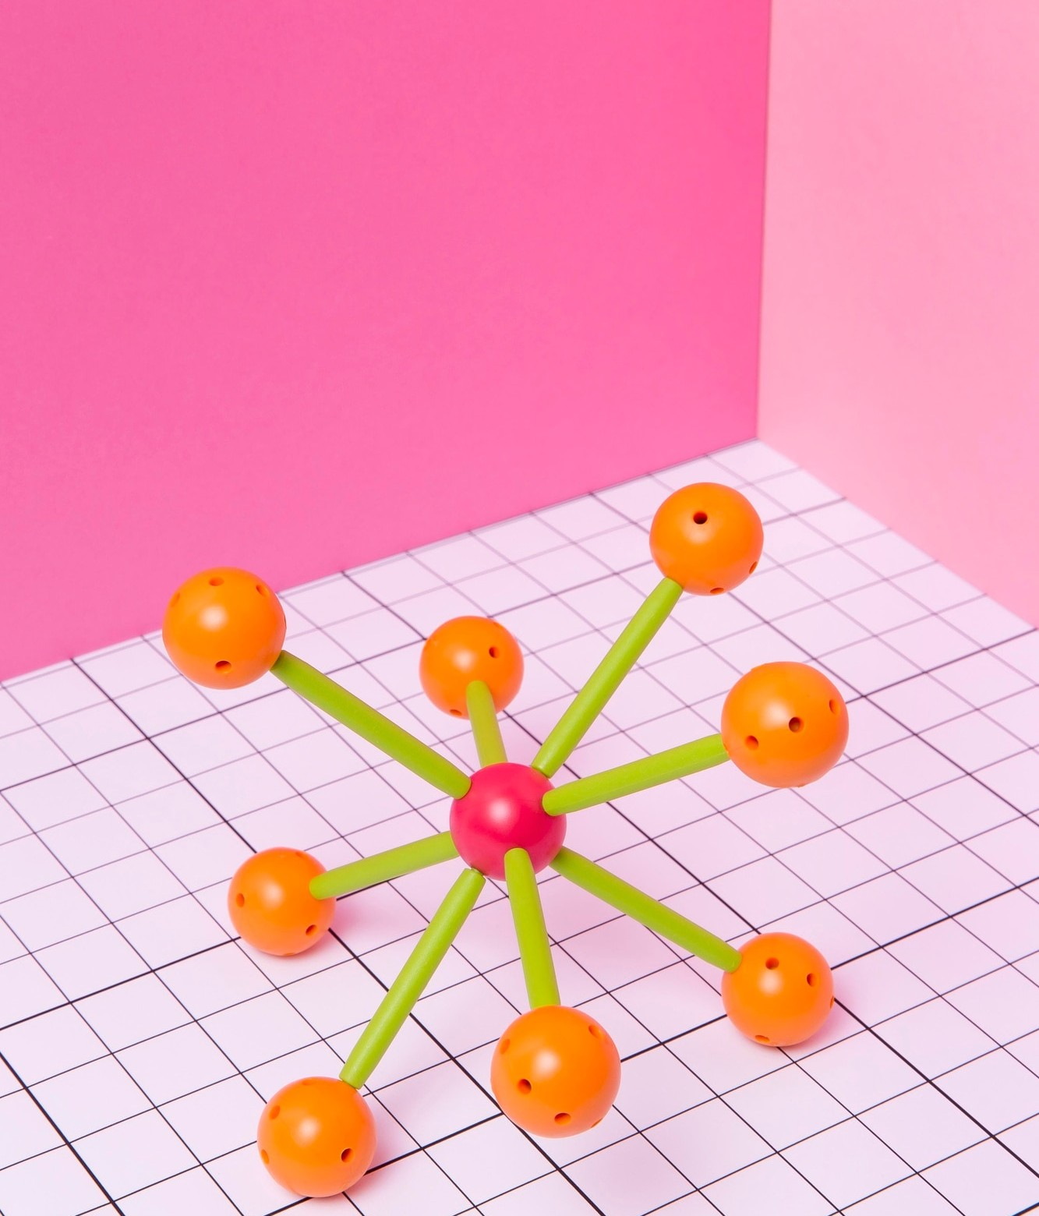
GENERATIVE ADVERSARIAL NETWORKS (GANS)
GANs are a type of artiﬁcial intelligence algorithm that consists of two neural networks, the generator and the discriminator, which work together to generate realistic data. GANs have shown promise in image generation and data augmentation tasks.

Slide 7
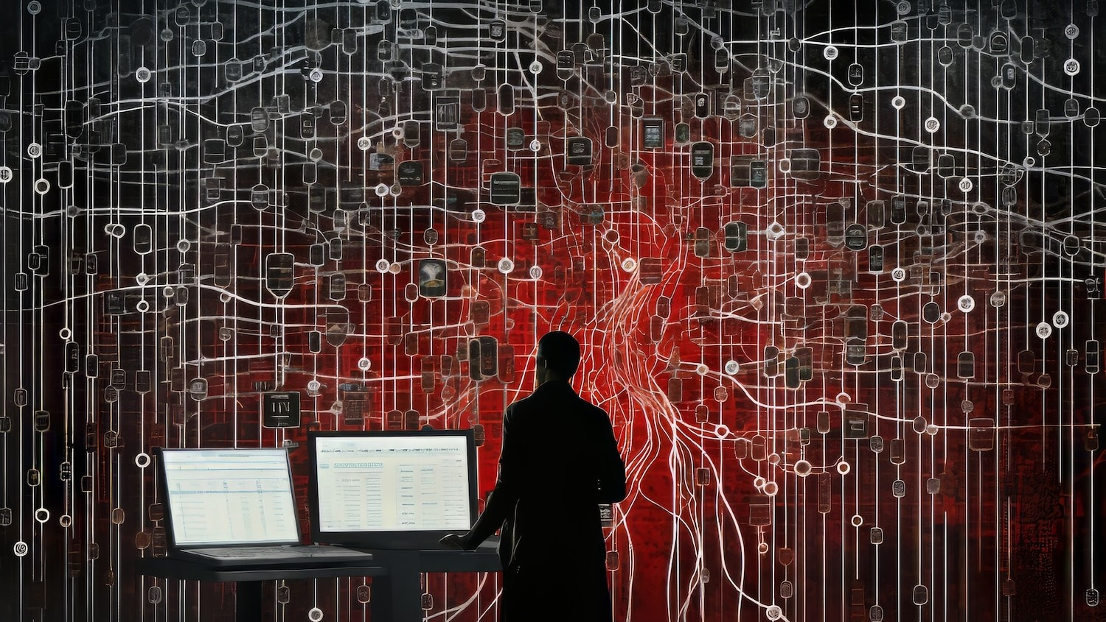
Application of GANs in Handwritten Digit Recognition
By leveraging GANs, we can generate synthetic handwritten digits to augment the training data, thereby improving the generalization and robustness of digit recognition models.
GANs can also help in style transfer for digit normalization.

Slide 8

Experimental Results
We conducted experiments to evaluate the performance of GAN- enhanced handwritten digit recognition models. The results demonstrate signiﬁcant improvements in accuracy, robustness, and generalization compared to traditional recognition models.

Slide 9
CONCLUSION
In conclusion, the integration of Generative Adversarial Networks in handwritten digit recognition presents a signiﬁcant opportunity to enhance accuracy, robustness, and generalization.
The potential of GANs to address the challenges in
digit recognition opens new avenues for practical applications.

Slide 10
Thanks!
JENOLAN ES au962821104041
University College of Engineering Nagercoil

